Slide 1
International Islamic University Chittagong
ABOUT
BUDGET
PROJECT
TIMELINE
Department of Computer Science & engineering
Course Code: CSE-3532
Course Tittle: Tools and Technologies for Internet Programming
Submitted To: Mrs. Atia Binti Aziz
Adjunct Faculty,
Dept. Of CSE,IIUC.
PROJECT PROPOSAL

Slide 2
PREPARED BY
ABOUT
BUDGET
PROJECT
TIMELINE
Name : Kanita Haider
ID : C201216
Semester : 5th
Section : 5AF
PROJECT PROPOSAL

Slide 3

A project Proposal On E-Commerce Web Application
ABOUT
BUDGET
PROJECT
TIMELINE
PROJECT PROPOSAL

Slide 4
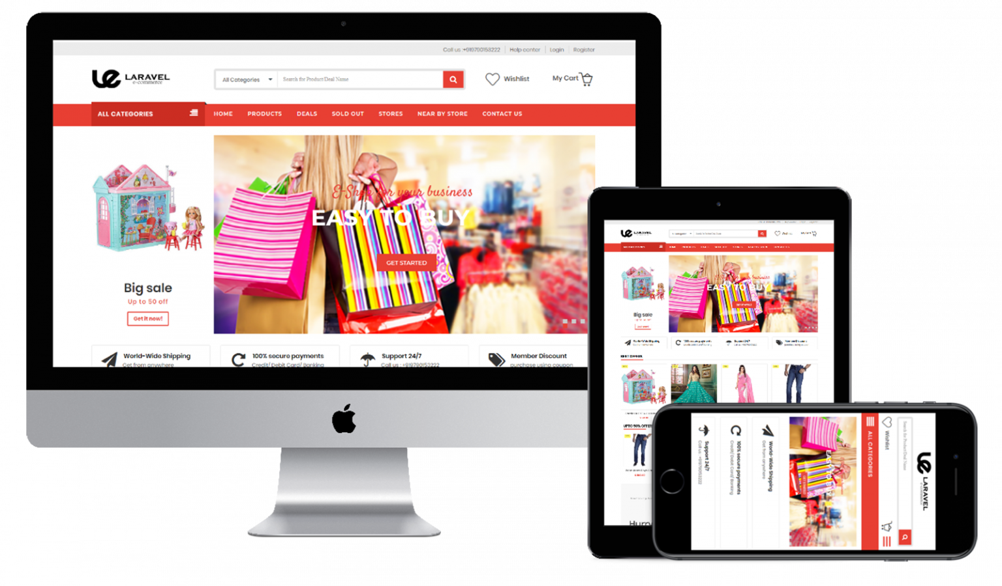
Intruduction
INTRUDUCTION
FEATURES
PROJECT
TIMELINE
01
Buying and selling of products on online service or over the internet is called e-commerce, and people who do it are commers.
PROJECT PROPOSAL

Slide 5
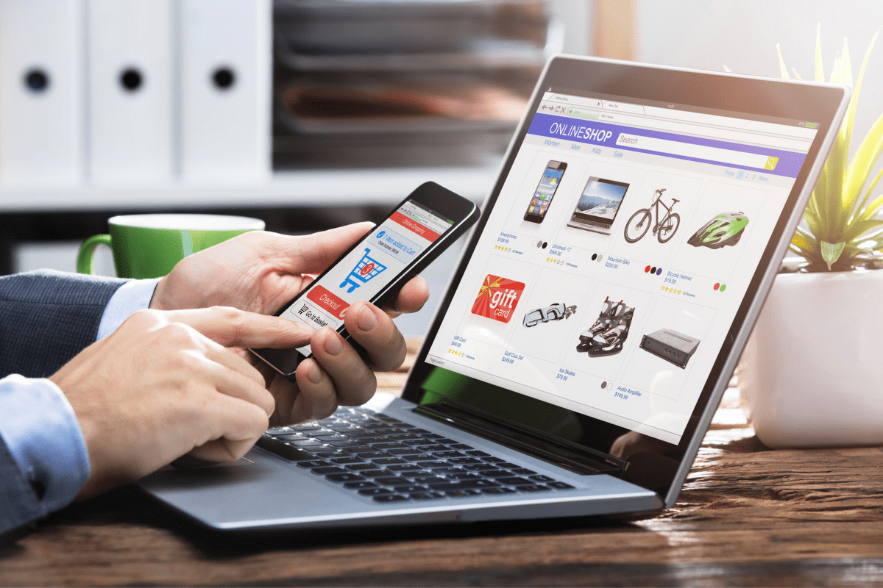
ABOUT
BUDGET
PROJECT
TIMELINE
Online shopping is a platform that embraces technology and at the same time incorporates the various needs of a people to enable them shop at their comfort.
I am doing an e-commerce online store call cara.com
Types of Users of the website are:
• Visitors
• Customers ( Registered Member )
• Admin
PROJECT PROPOSAL

Slide 6

Project objective
INTRUDUCTION
FEATURES
PROJECT
TIMELINE
02
To develop an online shop mall that will serve specific special needs of every customer
PROJECT PROPOSAL

Slide 7

Specific Objectives
Project
BUDGET
PROJECT
TIMELINE
1. View Home Banners or Slide Show Gallery
2. Browse Merchandises
3. View Product Details with ( HD Photos gallery, rapid climb, in and whizz out ) .
4. Become a Member through Registration procedure.
5. Add to cart
7. Payment.
9. Shipping
PROJECT PROPOSAL

Slide 8

Requirements
ABOUT
PROJECT
PROJECT
TIMELINE
03
PROJECT PROPOSAL

Slide 9
ABOUT
BUDGET
PROJECT
TIMELINE
Software Requirements
Operating System : Windows 7 or Higher
Front-End : HTML, CSS, JavaScript, Jquery, Bootstrap
Back-End : Php,Laravel,Mysql.
Database : phpmyadmin
Application : VS Code,Canva,Xaamp.
PROJECT PROPOSAL

Slide 10

Limitation & Future Scope
ABOUT
BUDGET
PROJECT
TIMELINE
04
PROJECT PROPOSAL

Slide 11

Limitation
ABOUT
BUDGET
PROJECT
TIMELINE
No Online Payment System
No features to contact admin via app
PROJECT PROPOSAL

Slide 12

Future Scope
ABOUT
BUDGET
PROJECT
TIMELINE
Delivery System and Parcel tracking
Blogging Site
More Payment Systems like bkash
Rocket
Paypal
Whatsapp Button
features to take feedback from Clients
PROJECT PROPOSAL

Slide 13
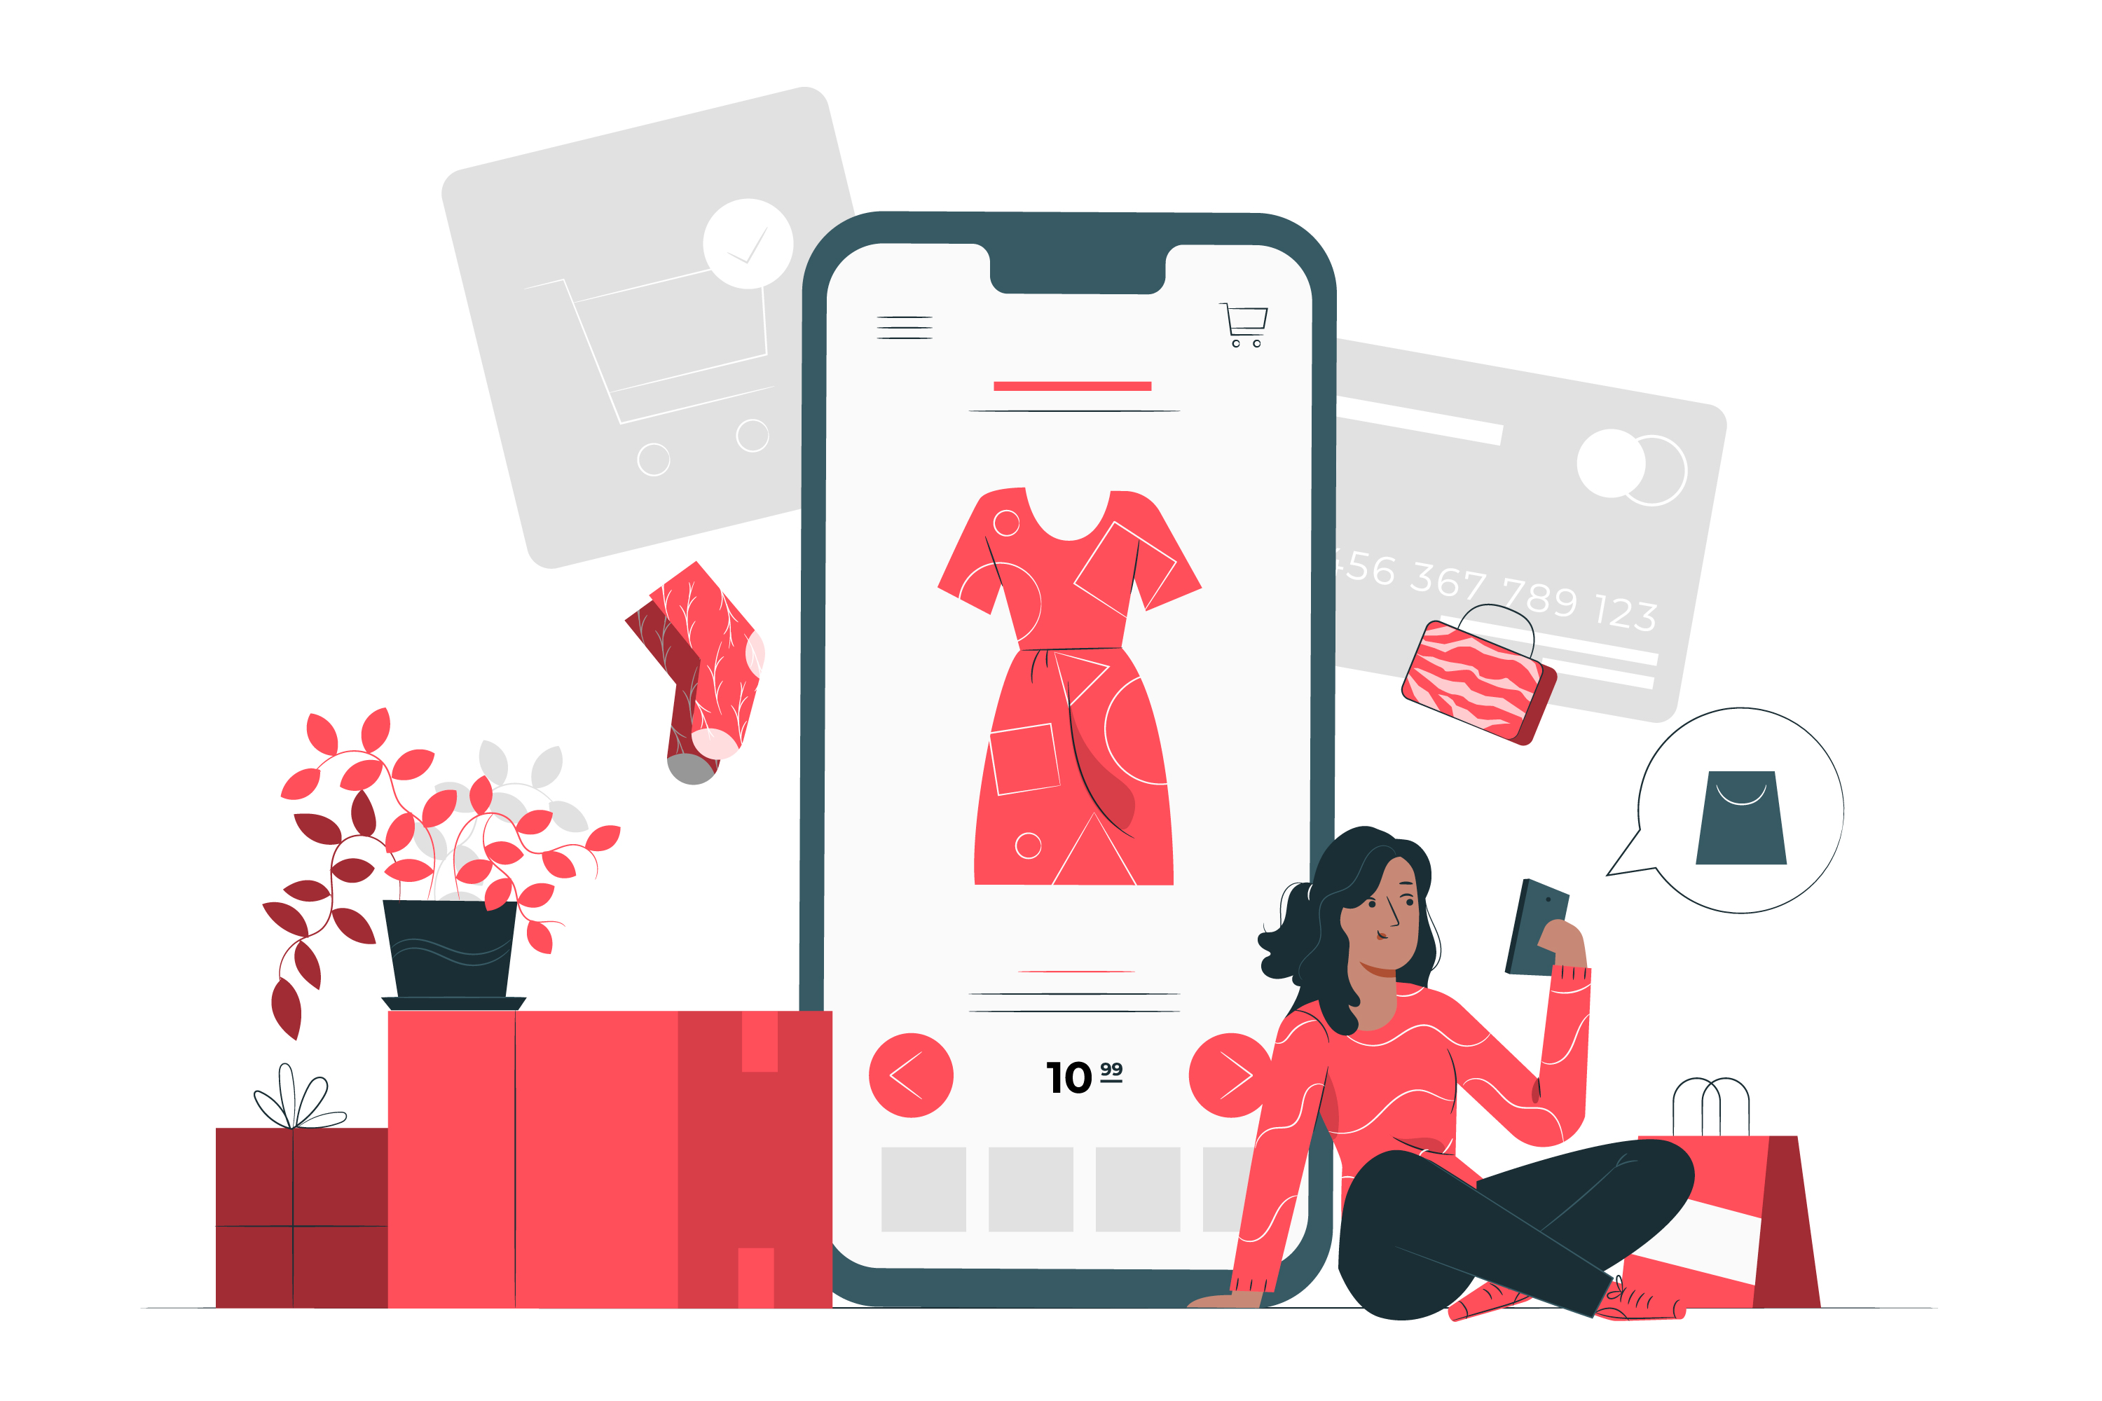
Feature Based Outcome
INTRUDUCTION
FEATURES
PROJECT
TIMELINE
06
PROJECT PROPOSAL

Slide 14

SNEAK PEEK
ABOUT
BUDGET
PROJECT
TIMELINE
Get full Source code Here
GitHub Repository: https://github.com/Kanita-Haider/Ecommerce-web-app
PROJECT PROPOSAL

Slide 16
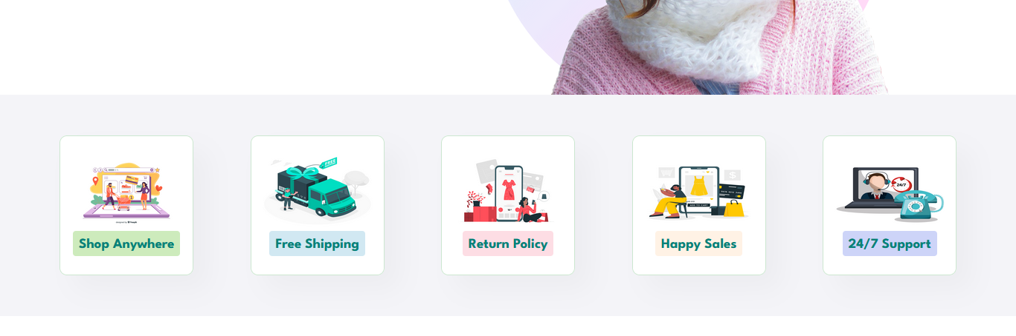

Slide 17
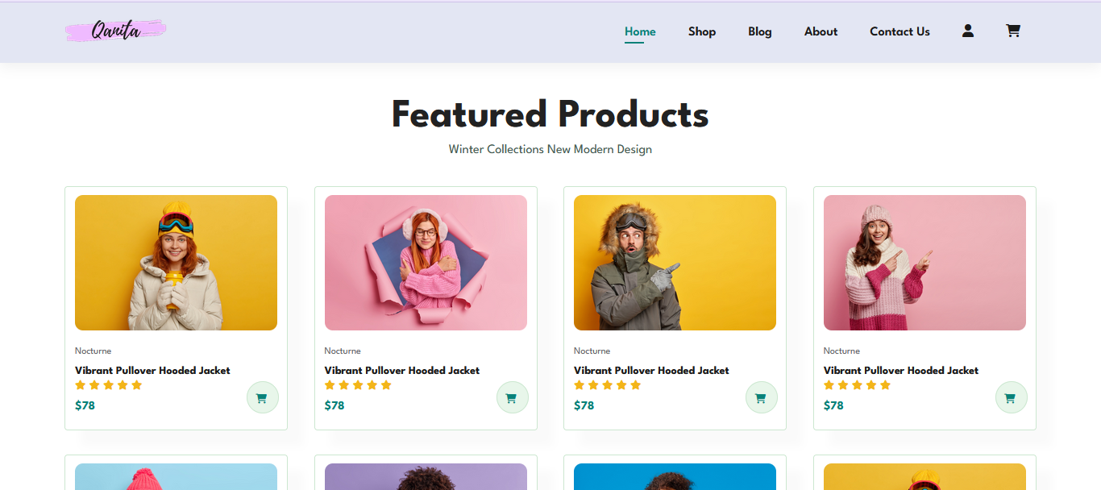
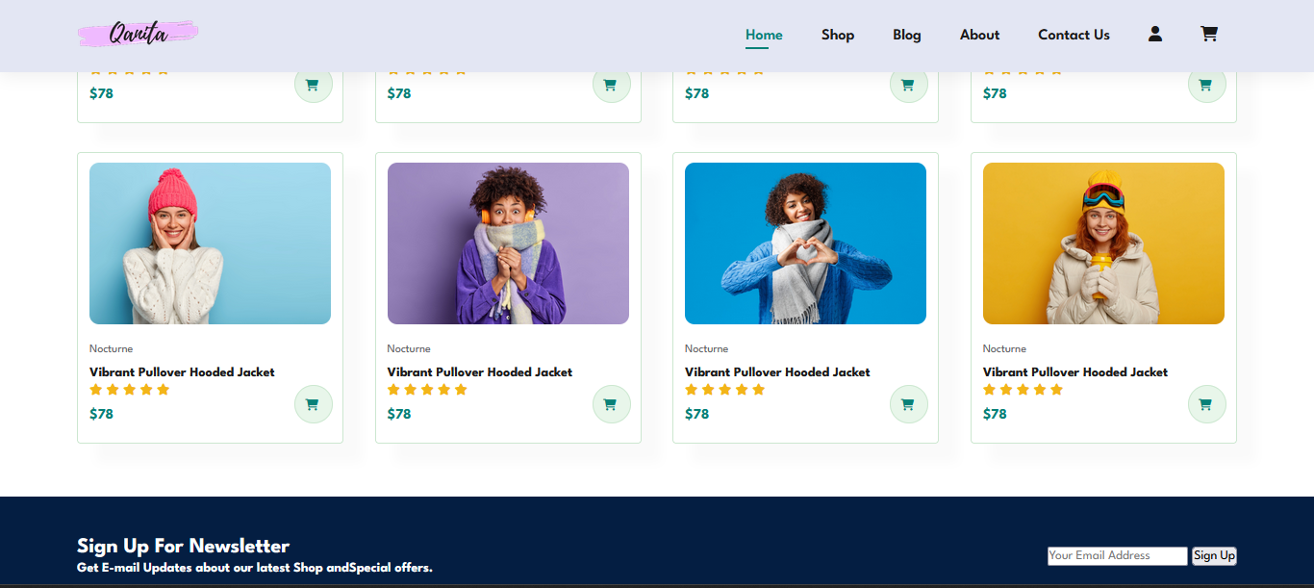

Slide 18
THANKS!
ABOUT
BUDGET
PROJECT
TIMELINE
Do you have any questions?
PROJECT PROPOSAL

